Slide 1

ASI – LatentView Engagement Status
30th May 2019

Slide 2


Agenda
Analytics Initiatives
1
2
Next Steps
3
Marketing Analytics
4
Dashboard Screenshots

Slide 3
Analytics Initiatives
Streams | Outputs / Delivery
Marketing KPIs | KPIs Dashboard (Monthly & Quarterly Views) Marketing Scorecard & Client Committee dashboard
UK Wholesale | UKW Targeting Dashboard UKW Campaign Reporting Dashboard (Incl. focus funds view) Model refresh & Target list for H1 campaign funds – 10
Brand Reputation | Brand Reputation Report
Budget Tracker | Budget tracker dashboard & automation completed
Client Retention | Client retention dashboards & web tool refreshed for data till Dec’18
***Across all stream wherever possible automation of data, model & dashboard refresh has been successfully set up

Slide 4


Next Steps
Option 1 - Dev & Support
Option 2 - Development
LatentView can own support for all streams with development for one chosen stream
LatentView can own development across two focused streams (Retention & Reputation)
Fixed Bid Project
Renewable every 3 months
2 Offshore Analysts
Onsite Manger – ½ Billed
3 Offshore Analysts
2 - Development
1 - Support
£60k for 4 months (c. £15k per month)
Option 3 - Support
Onsite Manger
1 Billed
LatentView can own maintenance & support across all streams
Renewable every 3 months
£75k for 3 months (c. £25k per month)
17% discount from existing pricing
2 Offshore Analysts
£30k for 3 months (c. £10k per month)

Slide 5
Next Steps – Option 2
Option 1 - Dev & Support
Option 2 - Development
LatentView can own support for all streams with development for one chosen stream
LatentView can own development across two focused streams (Retention & Reputation)
Fixed Bid Project
Renewable every 3 months
2 Offshore Analysts
Onsite Manger – 0.2 Billed
3 Offshore Analysts
2 - Development
1 - Support
£50k for 4 months (c. £12.5k per month)
Option 3 - Support
Onsite Manger
0.2 Billed
LatentView can own maintenance & support across all streams
Renewable every 3 months
£48k for 3 months (c. £16k per month)
2 Offshore Analysts
£30k for 3 months (c. £10k per month)

Slide 6
Detailed Next Steps
Option 1 - Dev & Support
Option 2 – Development (Fixed Bid)
LatentView can own the development across two focused streams
LatentView can own the support for all streams with development for one of the streams chosen (Option to renew every 3 mths)
Team Structure
Project Tasks
Onsite Manger
(50% billed)
2 Offshore Analysts
Brand reputation – Other language data
Data Extraction
Theme Modelling
Dashboard building
Client Retention
Data Prep & Model rebuilding
Team Structure
Onsite Manger – 1 Billed
3 Offshore Analysts
for development & dashboard refresh
Pricing & Timelines
Proposed steps for 4 month period - Fixed
£60k for 4 months ( c. £15k per month)
Project Tasks
Option 3 – Support
Regular refresh of all streams
Choose & execute next steps on one of the selected streams
LatentView can own the support across all streams (Option to renew every 3 mths)
UKW Focus Funds
Brand Reputation
Client Retention
Team Structure
Project Tasks
Marketing KPI
UKW Targeting & UKW Reporting
Monthly / Weekly refresh of all streams
Marketing KPI
UKW Targeting & UKW Reporting
UKW Focus Funds
Brand Reputation
Client Retention
2 Offshore Analysts
for refresh
Pricing & Timelines
Proposed steps for 3 months
£75k for 3 months (c. £25k per month)
17% discount from the existing pricing
Pricing & Timelines
Support for next 3 months
£30k for 3 months (c. £10k/ month)

Slide 7
Detailed Next Steps – Option 2
Option 1 - Dev & Support
Option 2 – Development (Fixed Bid)
LatentView can own the development across two focused streams
LatentView can own the support for all streams with development for one of the streams chosen (Option to renew every 3 mths)
Team Structure
Project Tasks
Onsite Manger
(0.2 billed)
2 Offshore Analysts
Brand reputation – Other language data
Data Extraction
Theme Modelling
Dashboard building
Client Retention
Data Prep & Model rebuilding
Team Structure
Onsite Manger – 0.2 Billed
3 Offshore Analysts
for development & dashboard refresh
Pricing & Timelines
Proposed steps for 4 month period - Fixed
£50k for 4 months ( c. £12.5k per month)
Project Tasks
Option 3 – Support
Regular refresh of all streams
Choose & execute next steps on one of the selected streams
LatentView can own the support across all streams (Option to renew every 3 mths)
UKW Focus Funds
Brand Reputation
Client Retention
Team Structure
Project Tasks
Marketing KPI
UKW Targeting & UKW Reporting
Monthly / Weekly refresh of all streams
Marketing KPI
UKW Targeting & UKW Reporting
UKW Focus Funds
Brand Reputation
Client Retention
2 Offshore Analysts
for refresh
Pricing & Timelines
Proposed steps for 3 months
£48k for 3 months (c. £16k per month)
Pricing & Timelines
Support for next 3 months
£30k for 3 months (c. £10k/ month)

Slide 8
Marketing Analytics – Project Status - 1
Streams | Outputs Created | Open Items | Future Scope | Business Benefits
Marketing KPIs | Marketing KPIs Dashboard (Monthly & Quarterly Views) ASI Marketing Scorecard & Client Committee dashboard (Monthly update) Data Layer - Weekly refresh of Websites, Email, Webcasts & Social Data (Automation wherever possible) | Email Data flow – Automation required AUM, Opps, CAR, Flows (manual) Tier & Meetings (Manual) | Socialize KPIs Indices dev Contact strategy (segmentation & profiling) Campaign vs Non campaign view of big five metrics | Tracking ROI on Marketing Spends Improved lead generation
UK Wholesale | UKW Targeting Dashboard (Used by UKW for audience profiling) UKW Campaign Reporting Dashboard (Incl. focus funds view) Model refresh & Target list for H1 campaign funds – 10 funds (Additional priorities added to UKW targeting) Automation of sources wherever possible | Email Data flow - Automation required Model impact view (manual) | Expand to other wholesale markets Improve campaign targeting (Websites & social) Build lead gen (Based on sales & campaign engagement) Socialize - UKW sales | Consistent Campaign ROI measurement across different wholesale channels Improved lead generation for sales teams

Slide 9
Marketing Analytics – Project Status - 2
Streams | Outputs Created | Open Items | Future Scope | Business Benefits
Brand Reputation | Brand Reputation Report (Delivered for March & April) Automation of all models required for brand reputation | License for Sysomos (Around $20k per year - Needed to automate data extraction) | Other languages (APAC & EMEA) Data extraction Theme modelling Dashboard building Extract Meeting notes data Socialize | Understand & track brand advocates Understand new topics & themes for own brand vis-à-vis competitors Gives an outside-in view for business
Budget Tracker | Budget tracker dashboard & automation completed | None | None | Useful to measure ROI on marketing spends
Client Retention | Client retention dashboards & web tool refreshed for data till Dec’18 | Data challenges for Aberdeen mandates: Email data automation Fund performance & consultant rating mapping missing Transactional data to flow through (July’19) | Data prep for h-SLI & h-AAM mandates Model rebuild for h-SLI & h-AAM mandates Business forecasting Note: Existing model unusable due to missing data | Understand critical clients & take mitigating actions based on factors leading to disinvestment Helps forecast to business on redemptions thereby enabling sales targets

Slide 10
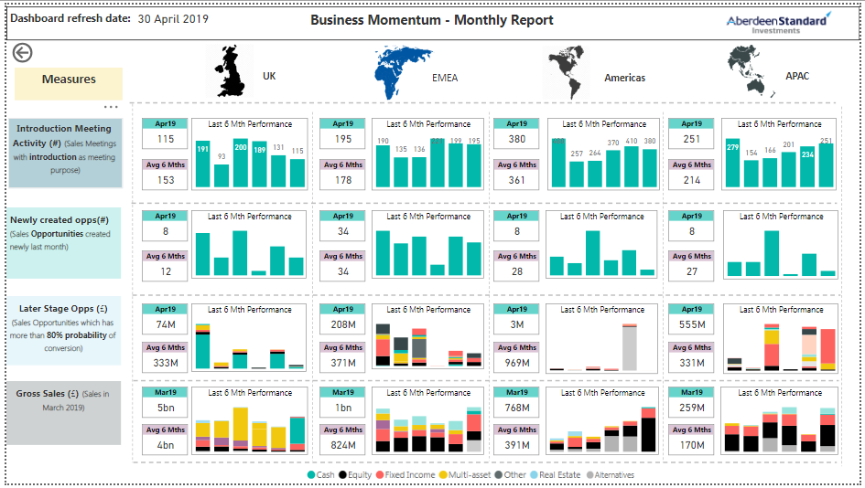
Marketing KPI- Business Momentum
KPI’s are tracked for the last 6 month period and relative performance of the current month is benchmarked on the last 6 month average
KPI’s capturing business momentum across different regions is tracked

Slide 11
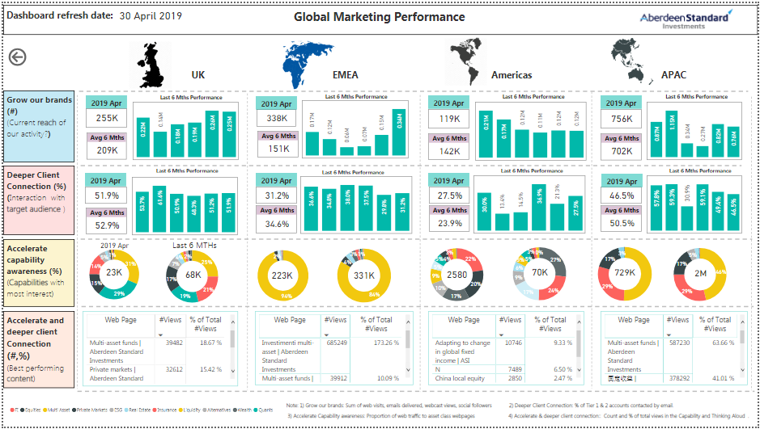
Marketing KPI- Global Marketing Performance
KPI’s are tracked for the last 6 month period and relative performance of the current month is benchmarked on the last 6 month average
The reach and engagement of the marketing activities are tracked across channels for different asset classes.

Slide 12
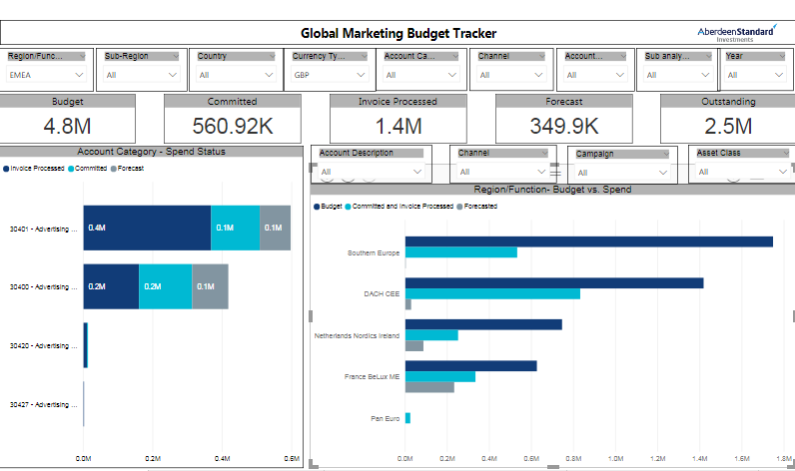
Global Marketing Budget Tracker – Home Page
Based on different user inputs, the budget and spend can be tracked.
Spend status across different account categories
Budget vs spend for different functions/region. Users can further drill down to view it across sub-region /country

Slide 13
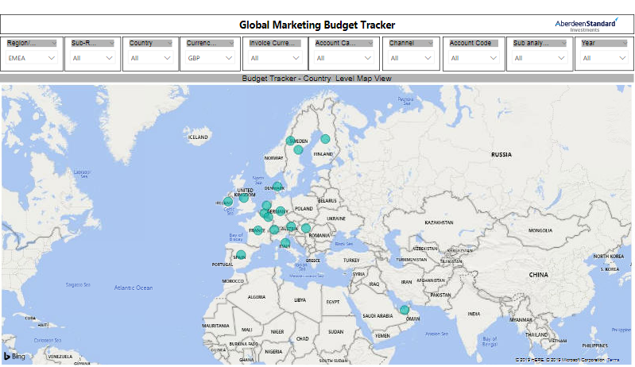
Global Marketing Budget Tracker – Geographical View
Country level view based on user inputs for different functions/regions

Slide 14
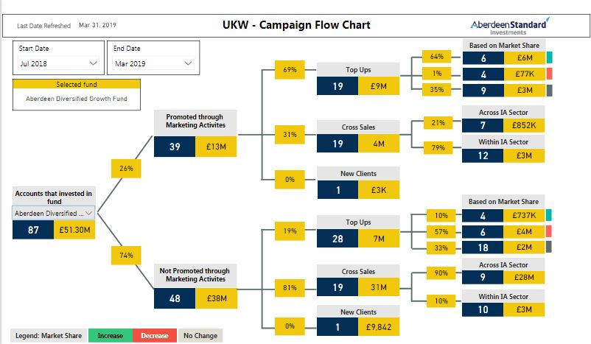
Campaign Flowchart- Focus Funds
Based on the start date and end dates flows can be tracked for each of the focus funds
Investments influenced by marketing activities
User can select funds for the analysis
Number of accounts
Investments by non marketed accounts
Money values

Slide 15
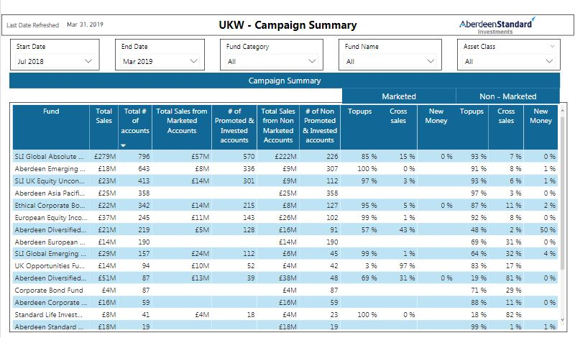
Campaign Reporting – Focus Funds Summary
Summary statistics for focus funds
Investments influenced by marketing activities
Investments by non marketed accounts

Slide 16
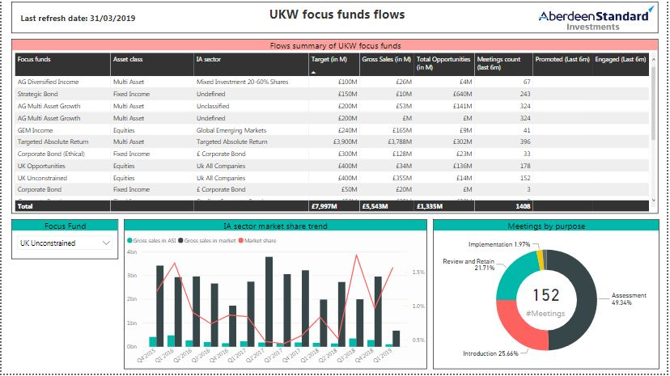
Campaign Reporting – Focus Funds Summary 2
Summary view of focus funds targets
IA market share trend for the focus fund
Meetings held by purpose for the fund

Slide 17
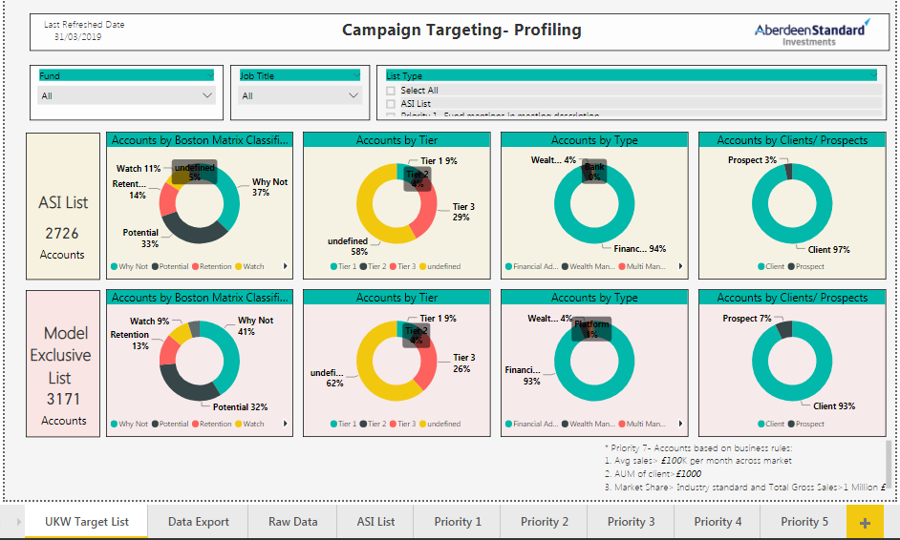
Campaign Targeting- UKW
Select the priority to generate the target list
Profiling of ASI target lists by BCG, Tier, Type and client/prospect
Profiling of Latentview’s target lists by BCG, Tier, Type and client/prospect

